Slide 1
Abstract Presentation & Viva Voce
REVA Academy for Corporate Excellence (RACE)
By,
RACE Program Office
May 5th 2021
race.reva.edu.in

Slide 2
Agenda
01. Abstracts Viva – Why?
02. Abstracts – Quick Review
03. Guidelines on preparing your deck
04. Best Practices during viva
05. Q & A

Slide 3
Why Abstract Viva
First Milestone!
Ensuring that no wheels are re-invented!!
Suggestions for improvement
Goal – Approval!

Slide 4
Abstract –Quick Review
Name of the Project
Back Ground Information
Statement of the Problem
Detailed Scope of work
Proposed Solution
References

Slide 5
Abstract - Common Errors
No Story!
Formatting, Proof reading and Layout errors
Placeholders not removed
Text written is not cohesive
No explanation or insights!
Not cited as per APA/IEEE style

Slide 6
Preparing your Deck
Well designed PPT with template
Maximum 5-6 Slides for a 15 minutes presentation
Appropriate usage of images with short descriptions
Use bullet points
PPT must speak by itself (without you!)
Do not use PPT as a Word doc!
Be Brief, Crisp and Professional
Use mild colours
Refer best practices on making PPTs from consulting firms
Deck Plan
Title Slide
Agenda
Back Ground and Introduction (~1)
Literature Review (1)
Problem Statement (1)
Proposed Solution (1)
Detailed Scope of work (1)
Conclusion (1)
Tell a Cohesive Story!

Slide 7
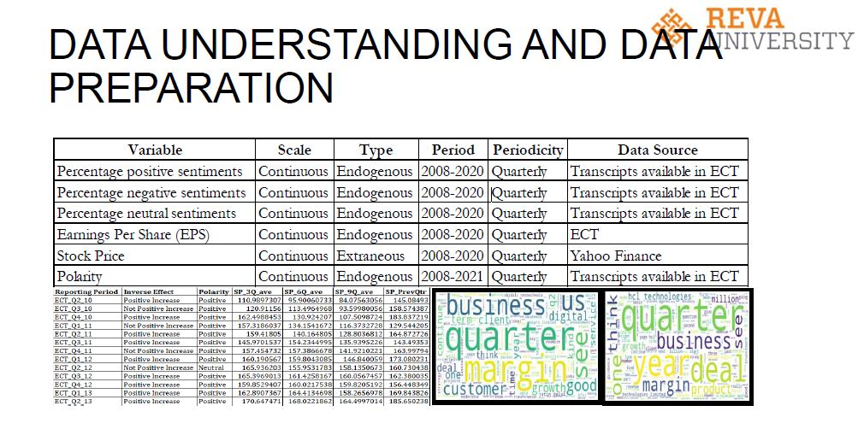
Common Errors
Do not write on the Logo
Two topics in the title of the slide! Keep one per slide.
The headline and the contents are not matching
Content not legible
Too much content
No insights highlighted
Word cloud and title are not matching.

Slide 8
Viva Format and Marks
15 minutes with Q&A
Industry mentors as Panellists
Marks Allotted – 10 (100)

Slide 9
Acing Viva?
Before Viva
Dress formal
Greet
Introduce yourself and the topic
Plan the timing
Professional PPT
PRACTICE!
During Viva
Explain the Agenda
Be Aware of the Concepts
Demonstration of the Project
Q & A
Do not Fake!

Slide 10
All The Best!

